Slide 1
Roadmaps of non revenue water :
Introduction(what is non revenue water)
Definition of non revenue water
Water supply of Indore
ERSs and borewells in ABD area of Indore
IMC table to check quality of water
Non revenue water in Indore
How we can generate revenue from NRW
critical issues prevailing with existing water supply system of Indore
Reduction of non revenue water
Reduction of NRW – use of advanced meter system
Synchronized water distribution system
Sustainable approach
References

Slide 2
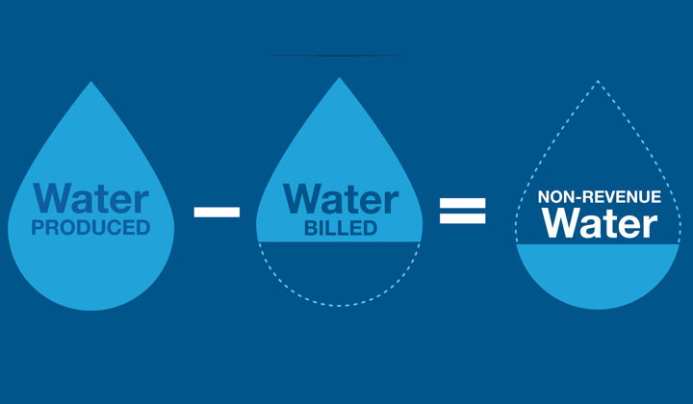
Introduction (what is non revenue water) :
Non revenue water is one of the most persistent problem in municipal water supply system .
It’s water that is pumped or produced but is subsequently lost or otherwise unaccounted in the system.
Non revenue water occurred due to many reasons (pipe leaks, illegal connections, unmetered public use, meter error, unsynchronised supply system, unbilled metered bill etc. )
It also refers to a difference between the volume of water entering the system and billed authorized consumption.

Slide 3
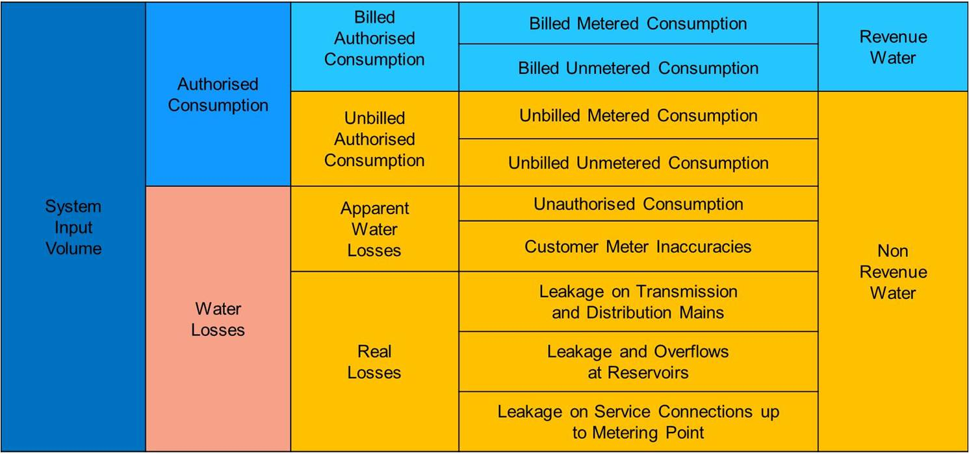
Definition of non revenue water(NRW)

Slide 4
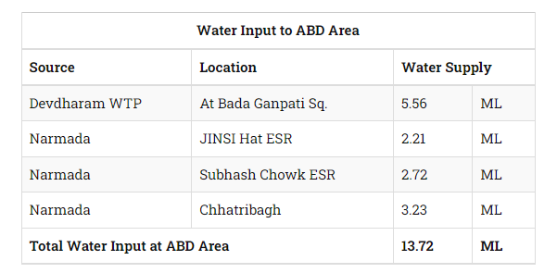
Water supply of Indore
Water inlet of ABD areas :
Bada Ganpati Square on Gambhir Line
JINSI Hat ESR on Narmada
Subhash Chowk ESR on Narmada
Chhatri Bagh ESR on Narmada
Present Water Supply sources :
Gambhir Line (Direct Supply)
ESR (3 Nos.)
Ground Borewells (350 Nos.)

Slide 5
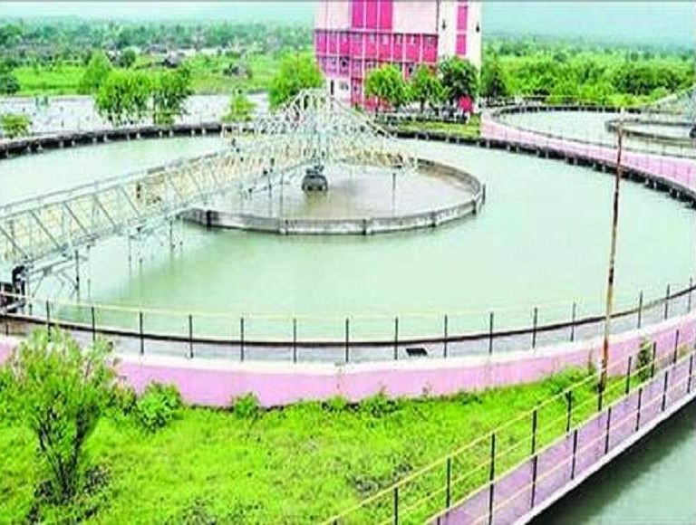
Indore Municipal corporation at present supplies 436 MLD of narmada water to city through three phases of pumping and supply systems installed at Jalood .
There are around 2.36 lakh household connected with water supply lines .
Indore extract water from Jalood which is 70 km away from city .
Jalood water distribution plant

Slide 6
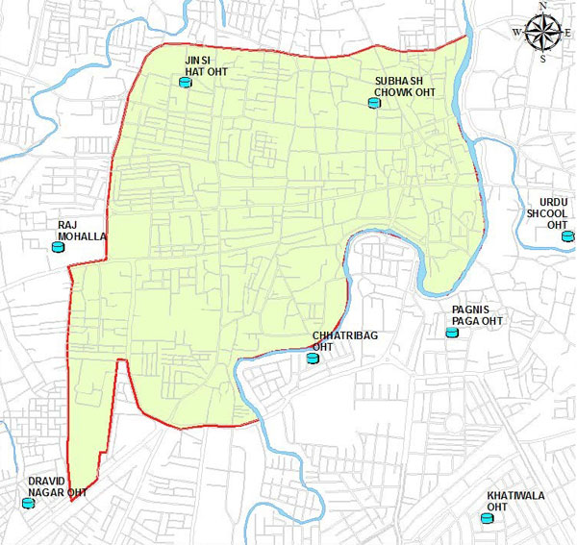
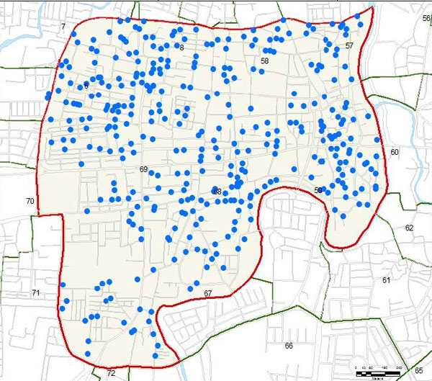
ESRs AND BOREWELLS IN ABD AREA OF INDORE
Location of ESRs in ABD Area
Location of Bore Wells in ABD Area

Slide 7
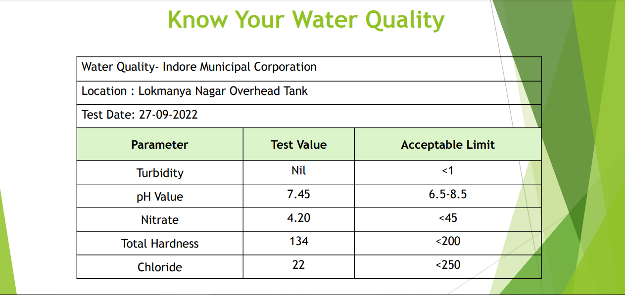
IMC TABLE TO CHECK QUALITY OF WATER

Slide 8
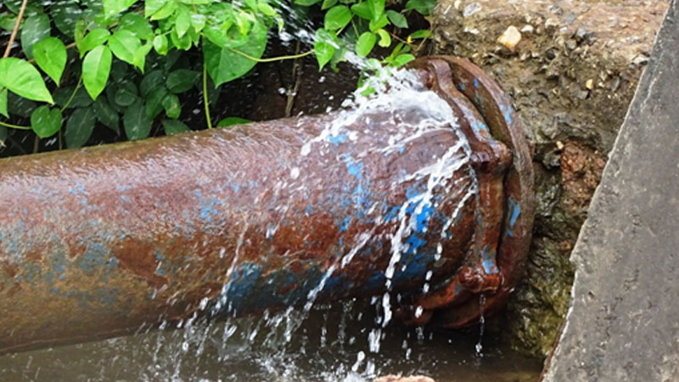
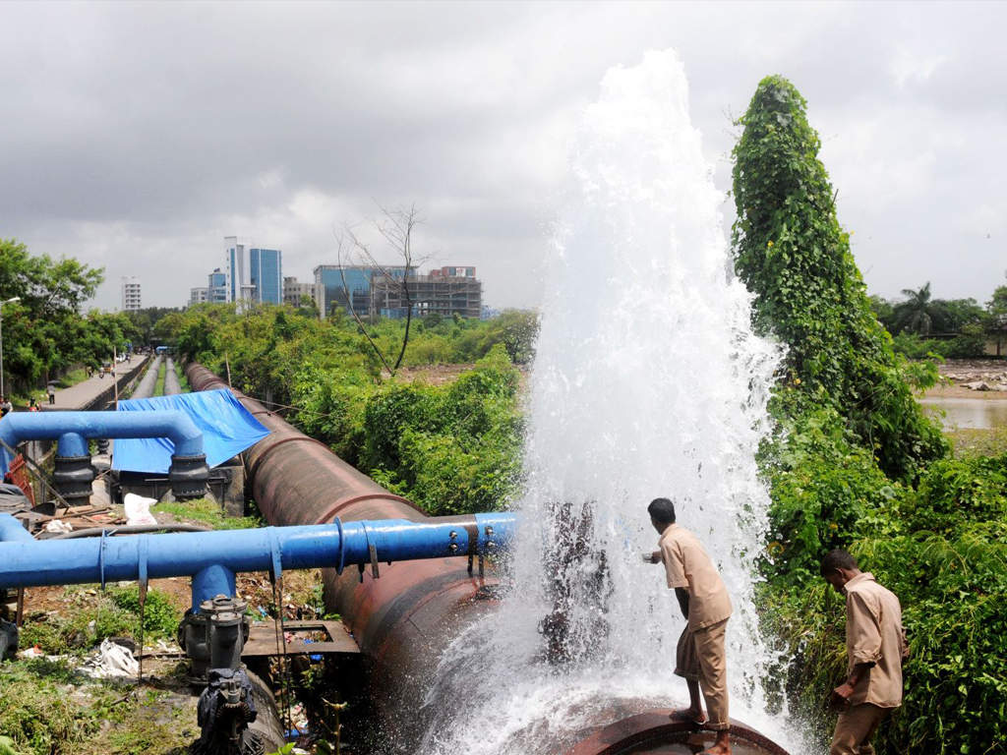
NON revenue water of our city
Approximately 35-40% water is become non revenue water in our city

Slide 9
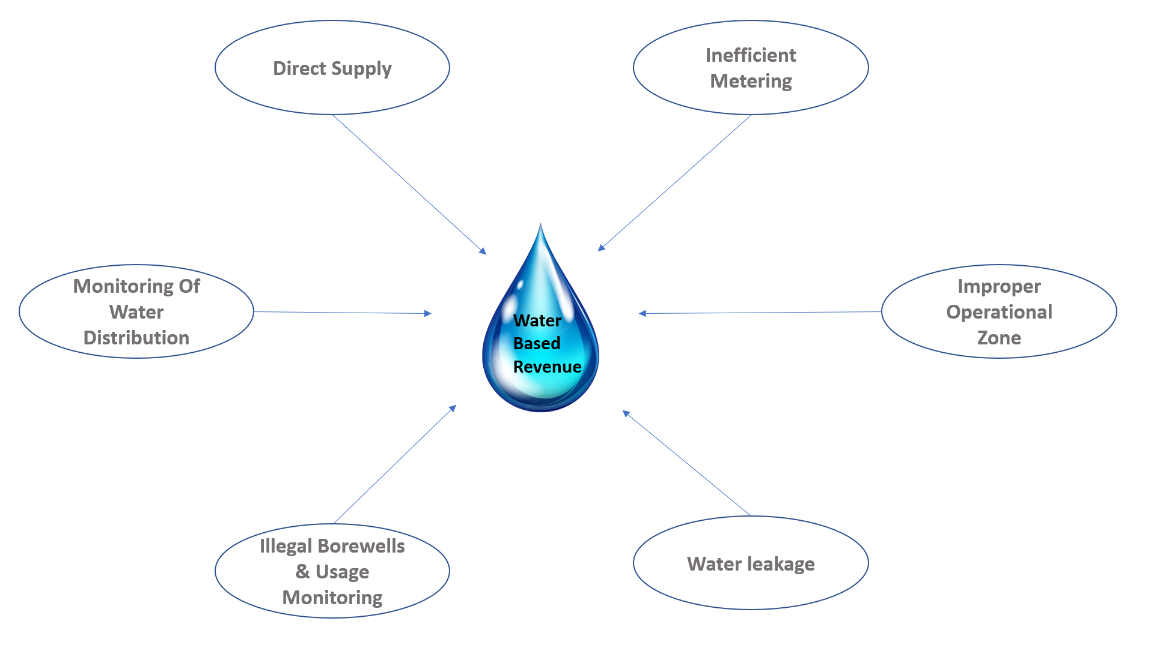
By solving these issues we can generate a good revenue from NRW

Slide 10
critical issues prevailing with existing water supply system of Indore
Direct Supply: the bulk water supplied into the system has too many direct tapping's for distribution of water. pressure drop and non-filling of ESR
Metering: The city does not have any metered water connections. Hence, the quantity of water consumption and the physical losses in the city is difficult to be estimated
Improper operational Zones: Serving zone served by each elevated service reservoir (ESR) was not designed as per their capacity. Despite disarrayed service area, existing pipelines have been found laid in haphazard manner.
Water Leakages: There is substantial loss of water due to old and worn out pipelines leading to leakage.
Borewells: Inadequate distribution network resulting less coverage area and dependency on bore well water / hand pumps. The shortfall in supply coverage is presently made, to some extent, by ground water through motorized bore wells.
Monitoring System: There is no proper instrumentation to monitor flow- pressure in transmission & distribution network. In absence of proper instrumentation system there is no accountability for water supplied and distributed. This is leading to un-efficient operation of the system.

Slide 11
Reduction of non revenue water
Determine system input volume Temporary flow measurement, reservoir drop tests, analysis of pump curves, pressure and pumping hours.
Determine billed metered, billed unmetered consumption from the utility of revenue system .
Estimate unbilled consumption
Calculate water losses

Slide 12
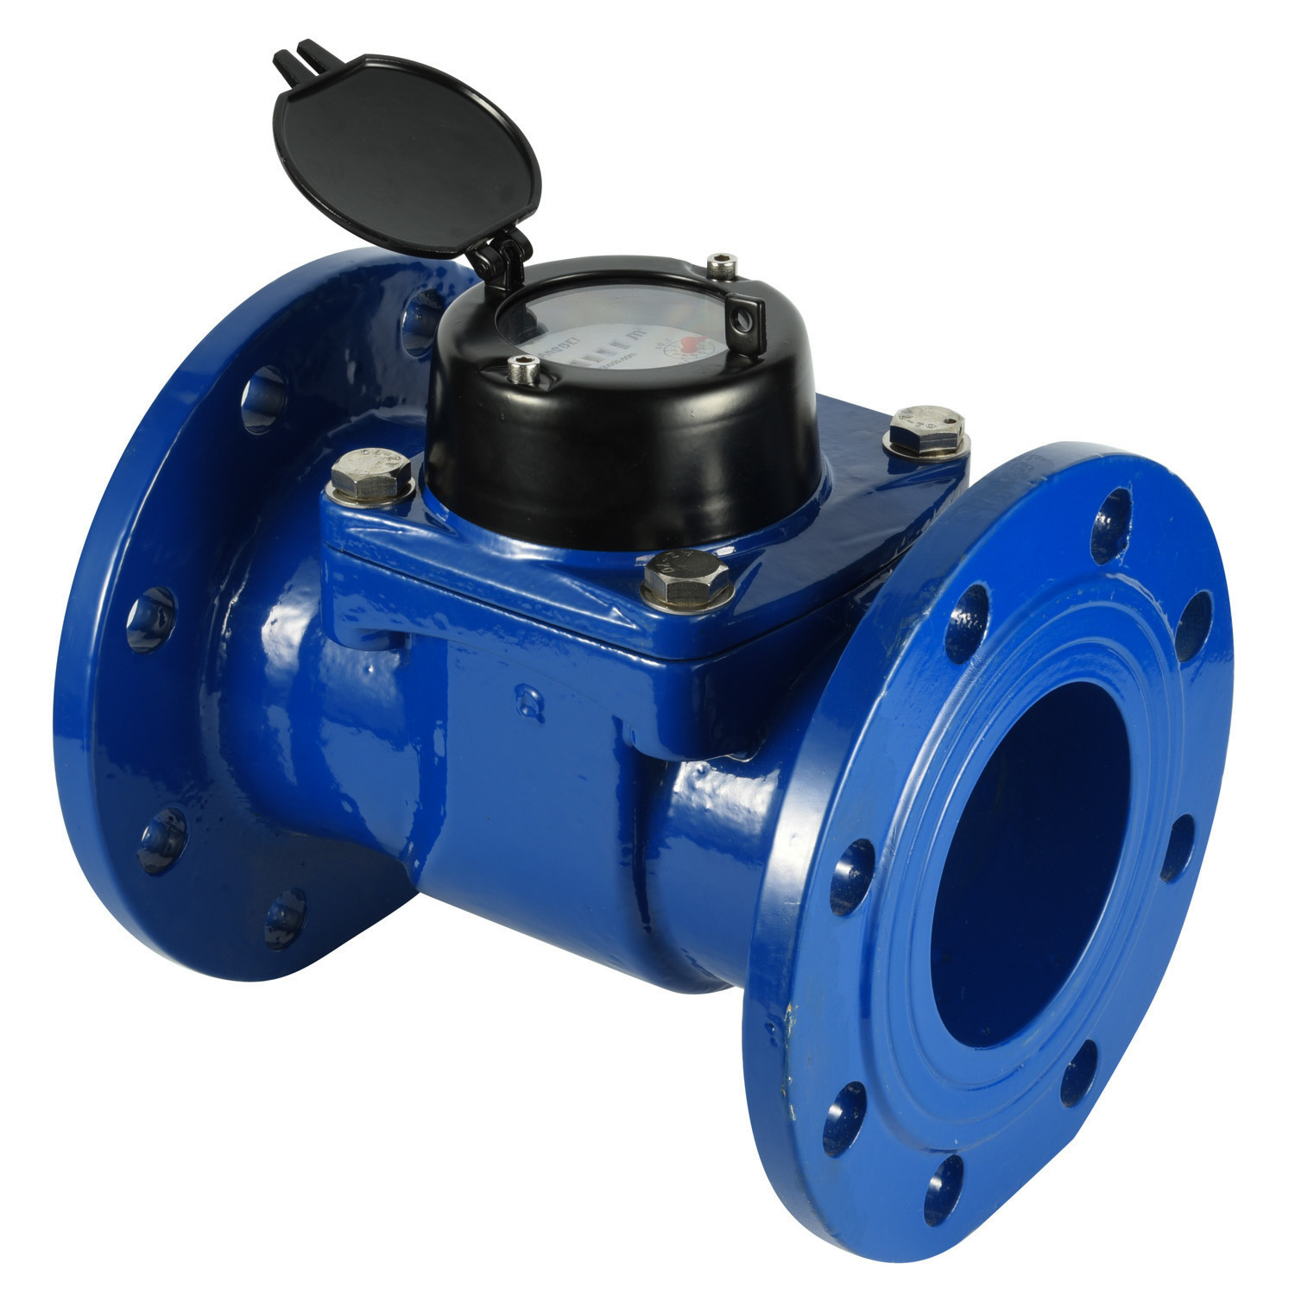
Reduction of NRW – use of advanced meter system
Automatic meter reading system – which transmits data to IMC.
Come with a drive-by system .
Eliminates human error.
Can give readings of water consumption of every house.

Slide 13
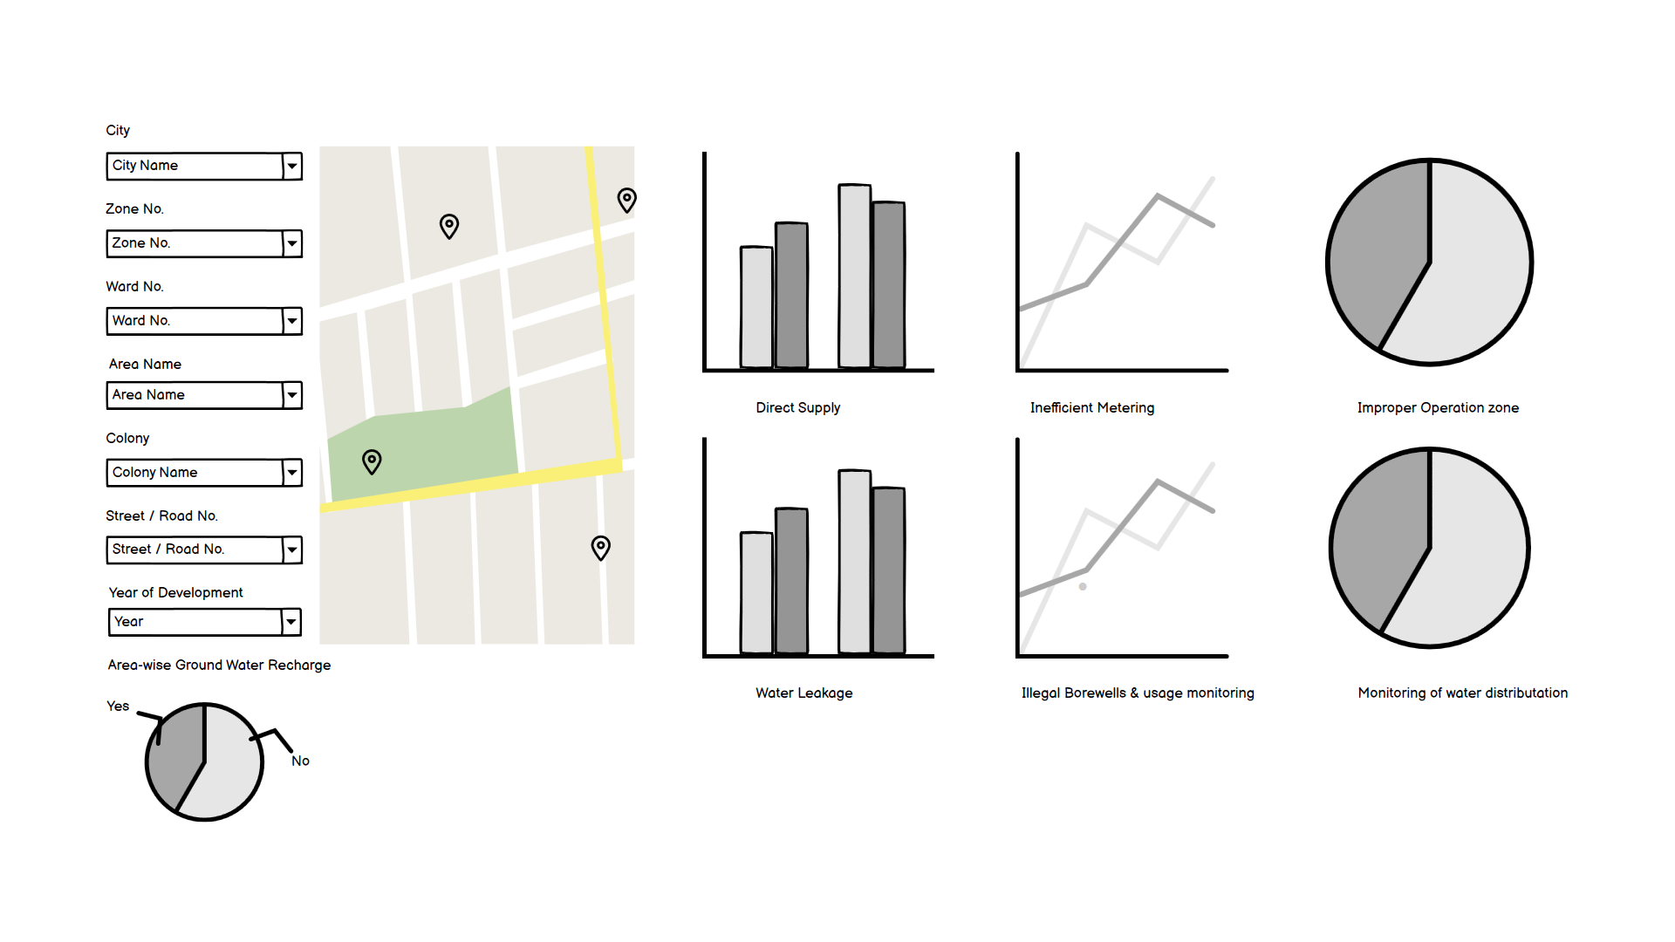
Synchronized water distribution system
Complete Dashboard for Indore water distribution analysis

Slide 14
Sustainable approach to reduce NRW in our city
Synchronized operational zones
Metered connection in every house
Deploying noise loggers for automatic leakage detection.
water distribution related data on a single dashboard
Proper monitoring system
Installation of flow and pressure monitoring instruments.
Find illegal connection using IOT based devices.
Automated water balance calculations.

Slide 15
References :
https://www.tatametaliks.com/non-revenue-water-management-nrw/
https://in.images.search.yahoo.com/images/view;_ylt=AwrPrFvw9bdjJ10ibqe9HAx.;_ylu=c2VjA3NyBHNsawNpbWcEb2lkAzM0YjM1MDZhYWZjN2JjOWU1NzlhY2NlZTFmNGM3ZjQ0BGdwb3MDMgRpdANiaW5n?back=https%3A%2F%2Fin.images.search.yahoo.com
Image(https://waterfm.com/wp-content/uploads/water-diagram.jpg)
http://timesofindia.indiatimes.com/articleshow/95057865.cms?utm_source=contentofinterest&utm_medium=text&utm_campaign=cppst
https://timesofindia.indiatimes.com/city/indore/imc-gears-up-for-centres-drinking-water-survey/articleshow/95057865.cms
https://www.smartcityindore.org/water-supply/
imcindore.mp.gov.in

Slide 16
Thank you

